Slide 1


Children’s Wellbeing Network Event
28 January, 2015
Shaping local priorities and
supporting a responsive market
Notes:
Go to insert > duplicate slide to add more slides

Slide 2

Welcome
Cllr Jenny Hyde
Cabinet Support Young People and Children’s Wellbeing
Happy New Year!

Slide 3

Herefordshire Children’s Wellbeing Network:
Shaping local priorities and
supporting a responsive market
Understand the population, their needs and voices
Identifying unmet need
Supporting communities and organisations to fill some of the gaps
Using available resources to commission evidence-based services
Driving innovation and continuous improvement

Slide 4
Networking making a difference
New supported accommodation for young people
Developing new capacity to provide short breaks for children with disabilities
Delivered Families First grant scheme
Family Information Service improved
Service mapping progressing – have a look!

Slide 5
Continuous improvement
3 times per year
Mix of information & activity
More time to network
Who’s in the room!?

Slide 6
Keeping in touch

Slide 7

Introduction and Housekeeping
Jo Davidson
Director of
Children’s Wellbeing

Slide 8
Children & Young People’s Plan
Children with disabilities
improve outcomes for children with a disability
Think family
develop a ‘think family’ approach and culture across the partnership to target resources and support vulnerable families
Youth offending
reduce the number of young people offending for the first time
Mental health
improve the emotional and mental health and wellbeing of children, young people and their parents and carers
Early years
improve outcomes for our youngest children (aged 0-5 years)

Slide 9
Review of 2014
Ofsted Inspection
New levels of need guidance Children’s Integrated Needs Assessment
Looked After Children & Complex Needs Sufficiency Strategy
Phase 1 of SEN reforms implemented, including the Local Offer and Education, Health & Care Plans
Early adoption of next phase of national troubled families programme
Improving schools & attainment
Autumn Statement

Slide 10
Looking ahead to 2015
Health & wellbeing strategy
Children & Young People’s Plan
Director of public health annual report
Early years strategy & review of children centre services
Children with disabilities transformation programme

Slide 11

Shaping Herefordshire’s Health & Wellbeing Strategy
Jo Robins
Consultant
in Public Health

Slide 12
Purpose of Presentation
To update the Children & Young People Stakeholder network on progress with the Health & Wellbeing Strategy
To sense check the priorities
To engage members in the consultation on the strategy
Notes:
Go to insert > duplicate slide to add more slides

Slide 13
Background and Context
Understanding Herefordshire – a key document is in place which identifies population need
The population grew by 6% during 2001-2013
22% of Herefordshire residents are aged 65+ (compared to 17% nationally)
The growth will continue and especially amongst the over 65 year olds (60% more people over 65 years in 2031) and double the number of 85 year olds
The number of people living with single or multiple long term conditions is growing
Life expectancy of our population is generally good but lower in less affluent areas
People in less affluent areas spend a greater part of their life living with a disability
High rates of alcohol related admissions among young people
The highest % of C&YP living in poverty in 2011 have remained static in the same two areas since 2006
Rates of breastfeeding, immunisations at 2 & 5 years are lower than the national average
There are high rates of tooth decay
Unintentional & deliberate hospital admissions injuries in children 0-14
Sparsely populated and large geographical county
Notes:
Our population is changing and we need to plan for that now
In the 22% figure that includes 5,500 people over the age of 85 years
We want to maximise life opportunities
Maintaining quality of life for longer

Slide 14
Making the Case for the Health & Wellbeing Strategy
The Health & Wellbeing Board has a duty to have a strategy in place
Can any one organisation be responsible for population health and wellbeing?
Our service infrastructure is fragile with a focus on higher level needs
Current services are overstretched
Rural inequalities may be hidden but greatly affect population health and wellbeing as identified in the case for change
Enables board members to hold each other to account
Resources are scarce
It must provide added value to create something better for the future
Must have an agreed set of outcomes with identified indicators reported on a regular basis
Notes:
CCGs, the NHS Commissioning Board and the LA to have due regard to the Strategy when carrying out their respective functions
To ‘jointly agree what the greatest issues are for the local community based on evidence in the Joint Strategic Needs Assessment (JSNA), what can be done to address them, and what outcomes are intended to be achieved'

Slide 15
Not Starting From Scratch
Vision and key principles in place
We have a strong case for change – the transformation programme across health and local authority
Proposals are in place for integration across service areas for health and social care
There is a long history of partnership working
A commissioning model is developing
The Better Care Fund proposal is in place
Developing new ways of working – public health, CCG, health and social care
Locality working and thinking about how we use our workforce resources
Key strategic documents in place with priorities of organisations
The voluntary sector is strong, diverse and proactive
Notes:
Key strategic documents include the LA –Herefordshire Council Corporate Plan, the CCG Five Year Plan, the NHS England Five year Forward-Simon Stevens

Slide 16
Proposed Themes
So far you have said
Cradle to grave approach
For children - starting well with pregnancy 0– 5 immunisations, breastfeeding, dental health, good education, maternal health, children with disabilities, young offenders, NEETS, Looked after children For adults – long term conditions, lifestyles (alcohol, weight, mental health)
Prevention and well being needs to be a strong feature in the strategy
Impact of housing, employment, economic growth, education and aspiration on wellbeing and reducing long term health inequalities
Special consideration – returning veterans, homeless, non English speaking, women – domestic abuse and sexual violence, families with multiple needs, those living in poverty
Mental health and wellbeing and the development of resilience in children, young people and adults
Hidden issues – alcohol abuse in older men & women
Notes:
Active travel team
Each local business has to have a sustainable travel plan
Having a job and a decent wage is crucial to health – Richard Wilkinson’s Spirit Level
Emphasise prevention is on a universal basis and is different from targeted intervention. Targetted all our resources to those in greatest need will not have the long term impact on reducing inequalities – Michael Marmot’s principles

Slide 17
What Are Our Assets?
Breadth and reach of the voluntary sector
A strong and resilient community
A great place to bring up children
People are used to doing things for themselves
Modest but proud communities
People help each other – people needing care are helped to stay here
Fantastic outdoor environment
Enterprise zone – attracting investment
People are used to managing through difficult times
Notes:
High church going county in the country
5000 pastoral visits per month – domicilary care – limited visits but the church could visit people who might be lonely
Hearing about excellent practice at parish level – parish nurses
During recession did not have the extent of redundancies
It’s a hidden gem, people have tremendous resilience
Very rich social support network of support

Slide 18
The Plan for Consultation with the Public - Proposals
Supportive Communities Working Group is our reference point
Commitment from partners there to support the development of the work and the consultation element
Sign up from lead officers in the voluntary sector and the main public sector organisations
Feedback on qualitative surveys completed from within our own organizations – using what we already have in place
Working with the expertise in the voluntary sector and parishes
Starting a health and wellbeing conversation with the public which will continue over time around self care
In the community hands on consultation – January to February 2015

Slide 19
Key Questions for Today
What do you think of the themes identified and do you endorse them?
Which top three would you choose?
What is your service/programme area already doing to support these ?
What ideas do you have to add to this that we could be doing?
How will you be part of taking this work forward?
Notes:
A plan for involving the public in influencing the decision making of the HWB?

Slide 20
Next Steps
Priorities identified based on JSNA, stakeholder feedback and public input
Agreeing a governance structure for the Health & Wellbeing Board
Firming up the outcomes
Developing the action plan on the priorities
Draft document in place end of March

Slide 21





Market Place & Service Mapping

Slide 22

Herefordshire’s
Integrated
Early Years Offer
Julia Stephens
Colin McKenzie
Jamie Lees
Notes:
Welcome to your new corporate Powerpoint template.
The margins are pre-set to align with the corporate composition zones - never move the guides.
Cover picture size is 254x98.04 (100px/in)

Slide 23

Integrated Early Years Strategy for
Herefordshire
2015 – 2018
Julia Stephens
Early Years Policy & Strategy Manager
Notes:
Welcome to your new corporate Powerpoint template.
The margins are pre-set to align with the corporate composition zones - never move the guides.
Cover picture size is 254x98.04 (100px/in)

Slide 24
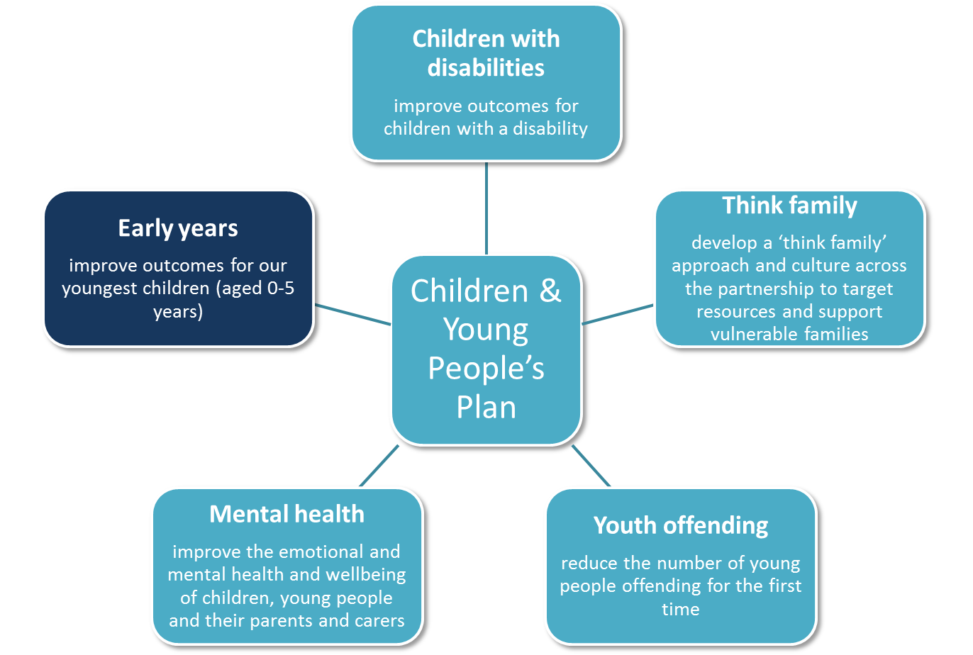
What are we going to do?
Improving outcomes for our youngest children is a priority for the Children & Young Peoples Partnership Plan.
There will be six early years work packages:
information, advice and guidance for parents and practitioners
using performance data
the nursery education funding offer
arrangements for disadvantaged 2 year olds
children centre services
the quality of early years settings
Notes:
Go to insert > duplicate slide to add more slides

Slide 25
Work Package 1 - Improve And Update Information, Advice And Guidance For Parents And Practitioners
The Family Information Service (FIS)
The SEND Offer
Parents looking for childcare
Nursery Education Funding
Enhance Website – Digital by default approach
Notes:
Go to insert > duplicate slide to add more slides

Slide 26
Work Package 2 – Monitor & Review
Performance Data
Ensure all 2 year olds taking up the 15 hour free entitlement are tracked through the system and monitored
Performance data is analysed and used to change, adapt and improve outcomes for children
Ensure performance data is accurate, clearly presented and informative
Notes:
Go to insert > duplicate slide to add more slides

Slide 27
Work Package 3 – Develop Further The Nursery Education Funding Offer For 2,3 & 4 Year Olds
Ensure we have sufficient early years provision to match nursery education funded children (statutory duty) and parental demands.
Roll out a clear NEF Policy for providers
Develop a web based search and feedback facility for parents seeking provision
Develop an online NEF payment process
Notes:
Go to insert > duplicate slide to add more slides

Slide 28
Work Package 4 - Support And Enhance Arrangements For Disadvantaged 2 Year Olds
  Improve the 2 year old learning and development summary. Assessment to be carried out in childcare settings once the child reaches three and moves on to NEF
  Ensure all early years providers carry out the assessment when needed and feedback results for tracking
  Establish a process for collecting and monitoring the data from early years providers in order to feedback results to the Early Years Strategy Group (EYSG)
Notes:
Go to insert > duplicate slide to add more slides

Slide 29
Work package 5 – Support Children Centre Services Review
Work with partners to review and develop a vision for the core purpose for Children Centre services in Herefordshire that is effective and sustainable
Develop a core specification and model of delivery that incorporates health and diverts demand from social care services
Develop agreed quality standards which includes the Annual Conversation, data packs & governance arrangements
Review & revise the health visiting model to integrate with the Early Years and Early Help Strategy
Ensure Health Visitors are aware, engaged and proactively supporting and disseminating the 2 year old offer
Notes:
Go to insert > duplicate slide to add more slides

Slide 30
Work Package 6 –Support And Improve The Quality Of Early Years Settings
Support for early years settings is proportionate to the risk factors identified through Ofsted inspections and local data.
EYFS results are on an upward trajectory and the percentage of children reaching a good level of development at the end of EYFS increases (target for 2015 - 65%).
Develop a model for improvement through a Herefordshire Early Years Improvement Partnership
Early years settings are competent in the delivery of all areas of learning in the EYFS framework
Work with settings to ensure a joint approach with Health Visitors to universal developmental checks for 2 year old children attending early years provision in Herefordshire.
Notes:
Go to insert > duplicate slide to add more slides

Slide 31

Review of Children’s Centre Services
Colin McKenzie
Consultant
in Public Health

Slide 32
The Review Brief
As a Children’s partnership the 5 key priorities we need to focus on are: -
Children with disabilities- improve outcomes for children with a disability
Think family - develop a ‘think family’ approach and culture across the partnership to target resources and support vulnerable families
Youth offending - reduce the number of young people offending for the first time
Mental health - improve the emotional and mental health and wellbeing of children, young people and their parents and carers
Early years - improve outcomes for our youngest children (aged 0-5 years)

Slide 33
The Review Brief....continued.
With a focus on Children’s centre services our priorities are to:
  Further integrate provision with community services - such as health visiting, school nursing, paediatric therapies, and emotional health and wellbeing (inc CAMHS) and adult services.
  Extend our reach into communities to engage with vulnerable families and those with complex and multiple needs, connect with Family First teams (Troubled Families agenda).
  Work locally with a wider base of community services to identify and intervene early with those families most at risk.
  Support behaviour change in families earlier and so reduce the need for them to access high cost, high demand services, especially social care.
  Develop strong arrangements with adult’s services and health community services and explore opportunities to maximise the involvement of the community and voluntary sector.

Slide 34
Key points to note
Children’s centres Services and the services that work with them, are key to the delivery of the priorities and to developing a community based approach.
We are looking to make the most of finances that are available.
The review is focused on NEED and services required to support that need. NOT a Children’s Centre buildings based review.
It is important to appreciate that funding for local authorities is set to reduce over the next three years.
The transfer of Public Health Services from the NHS to Local authorities provides further opportunity to do things differently.
In determining a new delivery model it is essential to gain the voice of the child from parents/carers and those of key partners and providers.

Slide 35
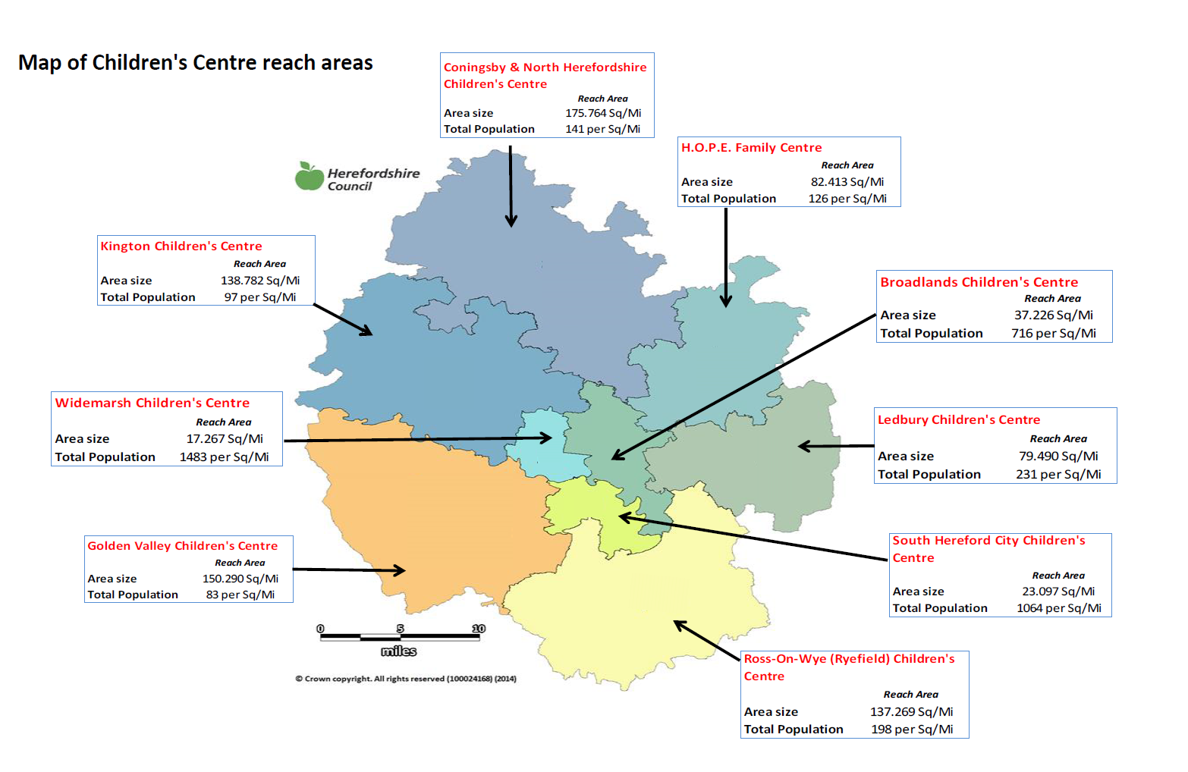
Where are we now?

Slide 36
Shaping the future?
The Key questions we need to ask ourselves to support the direction of travel for the Children’s Centre Services Review are:
Based on the priorities mentioned, what do we see children’s centre services offering moving forward?
What changes will we need to make to revise the offer?
How will we judge success moving forward?

Slide 37

Consultation of early years objectives
Jamie Lees
Commissioning Officer

Slide 38
Consultation format
2 x 15 minute workshops
You can pick from 2 of 6 workshops that are most relevant to you.
Workshops relate to the 6 work packages used to shape our Early Years Strategy

Slide 39
6 workshop options
Improve and update information, advice and guidance for parents and practitioners
Monitor & review performance data
Develop further the nursery education funding offer for 2,3 & 4 year olds
Support and enhance arrangements for disadvantaged 2 year olds
Support children centre services review
Support and improve the quality of early years settings

Slide 40

Children’s Wellbeing Network Event
Questions and feedback
Before you go…
Please complete an evaluation form
If you’d like to keep in touch with the network
then please join our Facebook page:
https://www.facebook.com/#!/pages/Herefordshire-Childrens-Wellbeing-Network/529977913758423?fref=ts

