Slide 1
Passenger Focus

Slide 2
Lets be honest……
Have you ever travelled in a vehicle and not worn a seatbelt?
Why Not?
Notes:
Ask the group if they have ever NOT worn a seatbelt and Why? Answers will include…..Broken, not enough, can’t be bothered, short journey, safe driver.
It would be worth mentioning here that that according to Insurance Companies data 52% accidents happen within 5 miles from home. Discussion point about not concentrating, familiar roads etc.
Highlight here that it is everyone's responsibility to wear a seatbelt and it is LAW. 14 years and above you are personally responsible for wearing your own seatbelt.
LEGAL STUFF –
All drivers must wear a seatbelt
All passengers 14 years and over are responsible for wearing their seatbelts
The driver is responsible for all passengers under the age of 14 years.
Will I or my passengers get fined for not wearing seatbelts……..YES, YOU WILL!
The fixed penalty for failing to wear a seatbelt as a driver or passenger is a £100 fine. If the case is taken to court, you could face a fine of up to £500.
Police don’t care that you may or may not have £100 in your bank account, you are still going to get the fine and have to pay that fine.
But, of course, the most serious penalty of all could be that you or a passenger loses their life!

Slide 3
Why do we wear seatbelts?
Notes:
Seatbelts reduce the risk of serious injury and dying by 86%.
How to wear a seatbelt – Fit snug over your collarbone, diagonally through the chest and lap belt must fit over your pelvis area. It can be adjusted up and down. Highlight not to wear over tummy and underarm. We should all wear seatbelts as they were designed to be worn as they help to save lives.

Slide 4
Video clip
Notes:
(show clip) – lets see what happens….. Ask what has happened in clip – what injuries would have occurred? What’s the difference in the two back seat passengers?
Airbags are an added safety feature not to replace seatbelts and are designed to reduce facial and upper body injuries (if seatbelt is worn correctly) Airbags are a controlled explosion whilst wearing a seatbelt it will cushion you however not wearing a seatbelt could result in injury from the airbag. Ask the group have you ever put your feet up on the dashboard? What injuries do you think would occur if you were in a collision? Spinal/pelvic injuries.

Slide 5
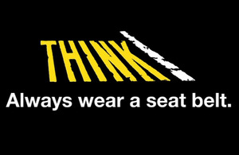
seatbelts
Notes:
Seatbelts reduce the risk of serious injury and dying by 86%.
How to wear a seatbelt – Fit snug over your collarbone, diagonally through the chest and lap belt must fit over your pelvis area. It can be adjusted up and down. Highlight not to wear over tummy and underarm. We should all wear seatbelts as they were designed to be worn as they help to save lives.

Slide 6
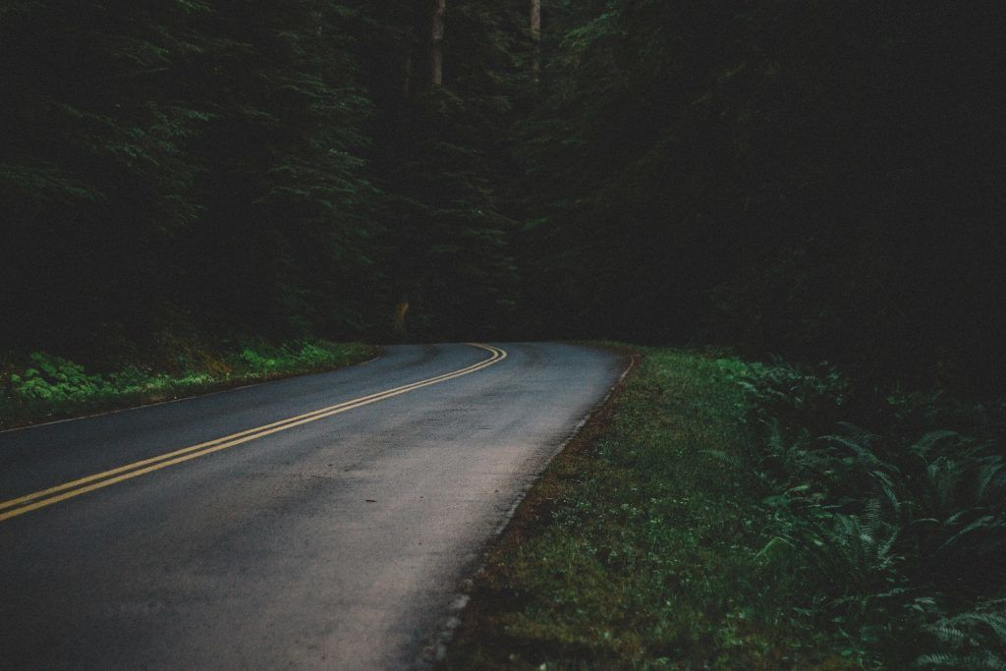
How are you going to get home?
How are you going to get home?
Notes:
5 chairs set up in formation of car prior to session
Ask for 5 volunteers to sit on the chairs
This is Robbo – you know him through a friend at school – you are at a house party Saturday night, no money for taxi, friends have already gone home, your phones dead however….Robbo has offered you a lift . QUESTION….Do you accept that lift. Discussions around the person could be drunk or have taken drugs, Is the car roadworthy? Final option would be…..You could stay the night, borrow someone's phone to call parents/carers/guardians to come pick you up.
ALWAYS think before getting in a car as a PASSENGER.

Slide 7
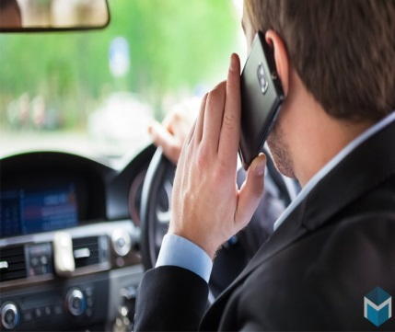
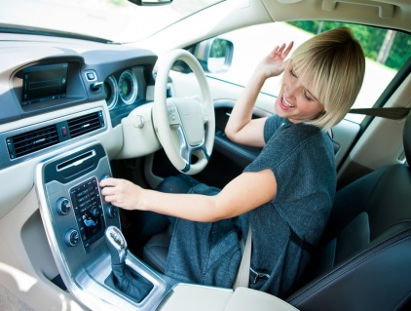
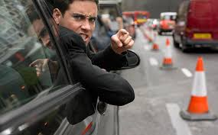
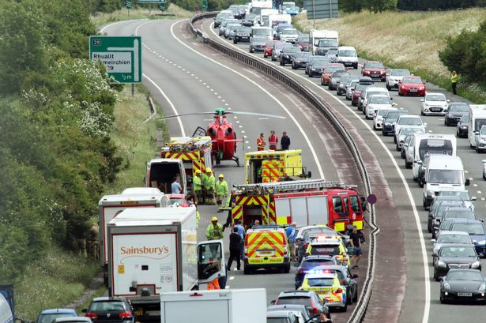
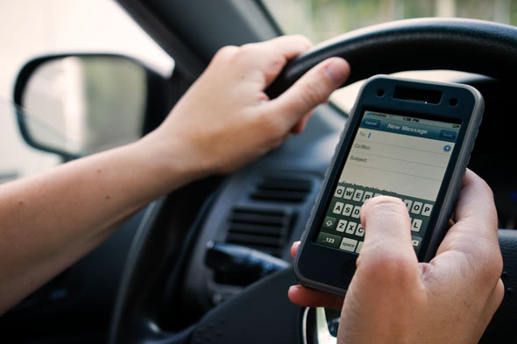
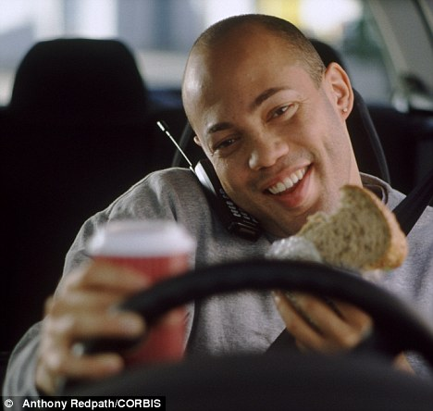
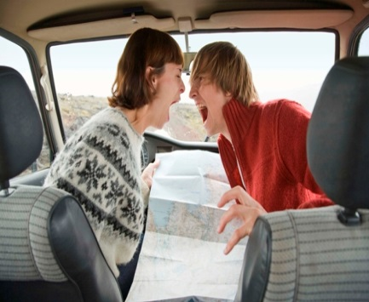
Distractions
How are you going to get home?
WHAT IS A DISTRACTION ?
Notes:
Firstly run through all things that are distractions using the pics above. Then….ask the question….”How can you be a better passenger?” Text for the driver, no arguing in the car, turn the music down, don’t distract the driver with eating (Pull over to pic nic) etc etc

Slide 8
The Distracted mind..
Notes:
Ask before showing the clip….”How many people think they can multi task?”. At this point most hands will go up. Show the clip then ask the question again re-iterating that essentially no one can multi task.
We can multi-task with non complex tasks for example – chewing gum and walking down the road – However driving is a highly complex task. The human brain is physically incapable of doing two cognitive tasks correctly at the same time, each task battles for attention – e.g. – holding a conversation and driving

Slide 9
YOUR Safety…
As a passenger do you have a right to feel safe in a car ?
If you felt unsafe, how could you make the driver slow down or stop so you could get out ?
Notes:
Facilitator to get 1 volunteer – Facilitator to be driving the car and acting as though they are driving fast/irresponsibly – Passenger who is student is asked to convince us to slow the car down – this is BEFORE showing the Coping strategies in the next slide. After one run through we will talk through as a group some coping strategies (Next Slide).

Slide 10
- Tell them straight !
Strategies...
- Pretend to feel sick or need loo
- Broken record technique
- Use “I” Statements
- Speed Camera / Police
Notes:
Second run through where we ask the student to use the coping strategies for us to slow down, once we have clocked they have used 2 or 3 coping strategies facilitator will slow car down and exercise will end.
This is a really important slide as it gives the young people strategies for them to use if they feel unsafe in a car. Run through each point.

Slide 11
Not just me…
How we behave as a passenger can affect everybody’s safety on the roads…
Notes:
You will learn more about the Ripple Effect in other workshops today

Slide 12
Think about Your Impact!

Slide 13
Knowledge Check …
What age are you responsible for wearing your own seatbelt?
What % of accidents happen within 5 miles of home?
Wearing a seatbelt reduces the risk of dying by how much percentage?
Give me three ways you could be a better passenger?
If you feel unsafe….Give me two ways to make the driver slow down or stop the car?
Notes:
Quizz to be used at the end to check out young people’s learning.
END OF SESSION

