Slide 1
Road Safety

Slide 2
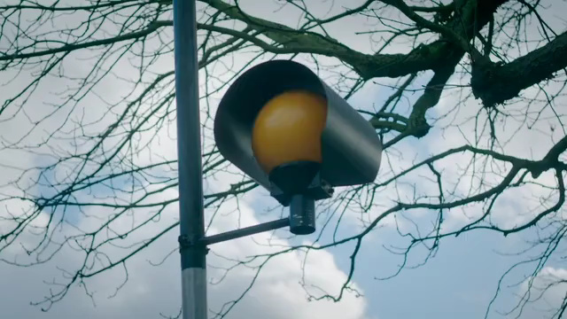
First Journeys
Notes:
This film shows children talking about their first journeys without an adult. How they felt a little scared but also excited.
You may already be allowed to walk around on your own or walk to and from school so you have some experience. The lesson today is to revisit some of the things you’ve learned in primary school about road safety, lessons in Year 1,2 and pedestrian training in Y3 when we went out for a walk to practice and to get you thinking about the simple things you can do to keep safe around roads.

Slide 3

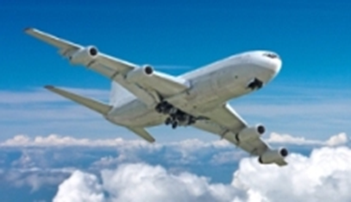
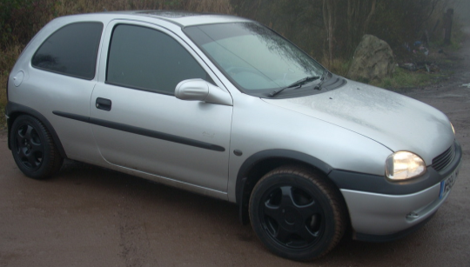
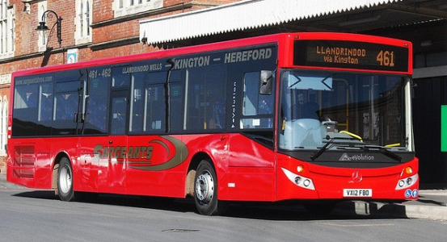

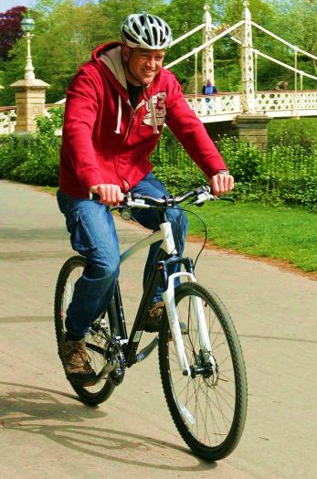
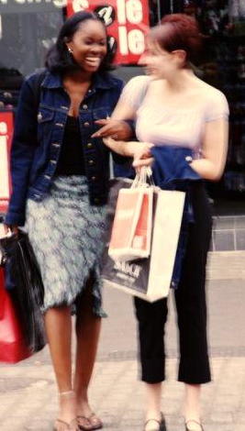
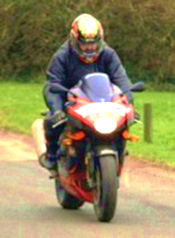
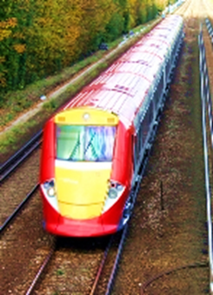
Is there a ‘safe’ way to travel?
Notes:
There’s lots of different ways we travel.
How do we think about how we travel? If we do things every day, like walking, does this make them safer? Why are some people scared of flying? If we do something everyday do we still remember to check carefully and not take risks? Is it easy to think I did it like that yesterday and every day before and I’m ok so it must be alright to take risks?
Discuss in pairs/table. – ask children to thing about which mode is ‘most safe’ and ‘least safe’ - ask around the room to those who volunteer, what their answer is and why? From their answers ask why do we hear about planes that crash on the news but unlikely to hear about a pedestrian (explain what this is in case some don’t know the word) who is in a collision on a crossing with a car? Because planes don’t often crash, if they do it’s newsworthy, peds unfortunately are involved in collisions every day. If they need convincing of this – 5 children are killed or injured every day on UK roads.
Discuss how we think about risk – nothing is risk free but we must learn to manage them so we can enjoy a full life. Some risks are not worth taking but some are – discuss risky hobbies – football, rugby, horse riding, roller coasters – almost everything has risk. The stairs in your house are risky – lots of accidents happen on stairs!

Slide 4
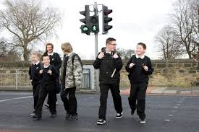
What makes these road users vulnerable?
Notes:
Our job as RS officers is to education and train people, particularly children, to be safer road users, including pedestrians. Our jobs exist because we (human beings) are vulnerable, especially on roads with traffic. Why? Discuss the differences between sitting in a car (protection, safety features) and walking or riding a bike – no metal cage so our injuries will be worse. Peds/cyclists are small so drivers may not see us. But, we do know how we can help ourselves to as safe as we can be, we’ve learned the rules throughout school.

Slide 5
Older children are more likely to be involved in a road traffic collision than younger children.
Why is this?
Less adult influence
Less experience
Distracted by friends/phones
Risk taking/Peer Pressure
Over confidence in ability
Notes:
Older children are more independent – less likely to be with an adult
More likely to be in a group of friends, may be distracted by friends, phones etc
They think they know how to use the road so might be careless
Might encourage each other to do silly things. Peer pressure

Slide 6
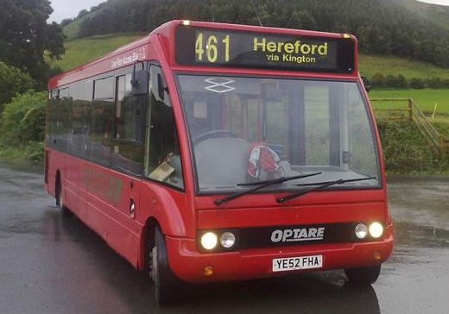
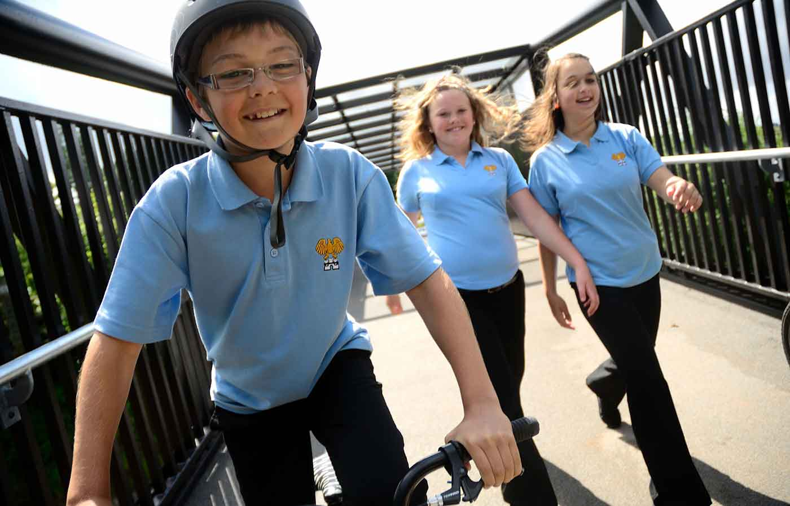
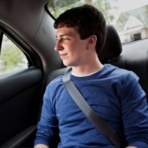
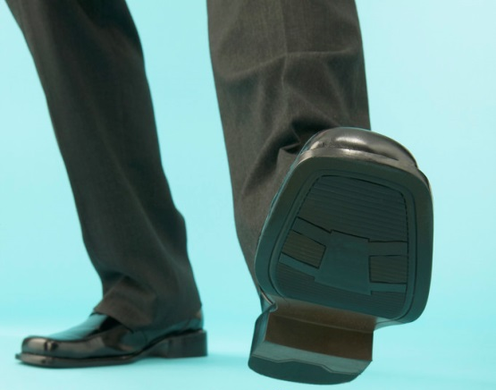
How you get around
Notes:
You’ll soon be moving on up to year 7 and High School and you may be making the journey to school on your own for the first time.
How will you be travelling to your new school? (Get their responses)
Pedestrian? Cycle? Passenger?

Slide 7
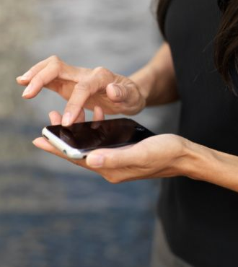
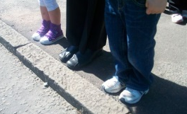
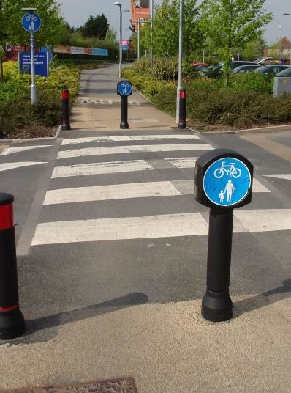
Pedestrian : Green Cross Code Distractions Route Plan
Safer crossing places
Notes:
Thinking as a pedestrian what can we do when crossing the road to be safer?
Green cross code
What could we use when crossing the road to help us?
Pedestrian crossing
If we are walking where there isn’t a footpath or pavement which side of the road should we walk on?
- The right. Towards traffic so we can see what’s coming

Slide 8
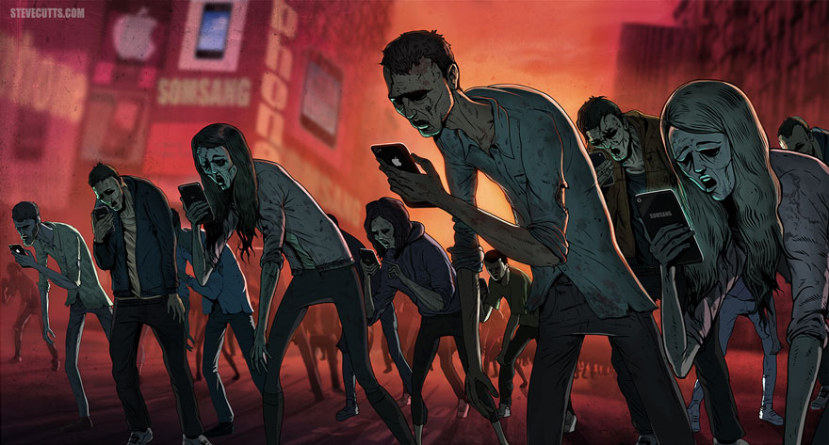
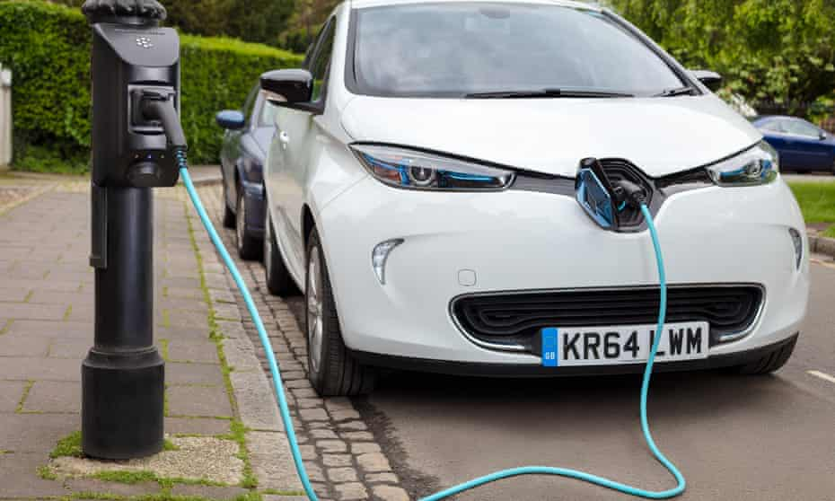
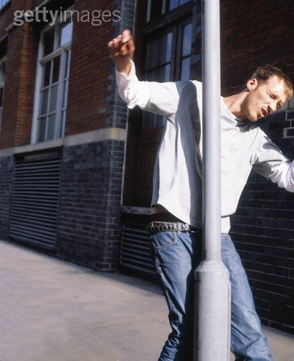
Awareness! don’t be distracted
Notes:
An increasing number of pedestrians are getting hurt because they are distracted, mainly by using their phone when crossing the road but also just not paying enough attention to what is going on. We all know that if we rush it’s easy to make a mistake, if we don’t look or listen properly and are in a rush that’s a disaster for us. If we make a mistake on our work at school, easy, rub out or start again. On the road? You might not get a second chance.

Slide 9
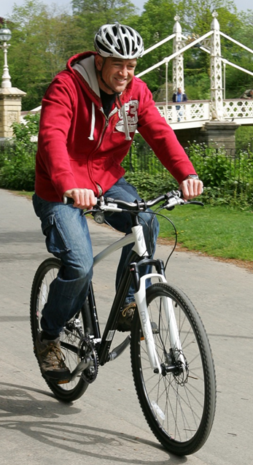
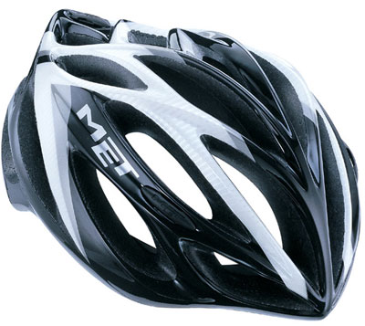
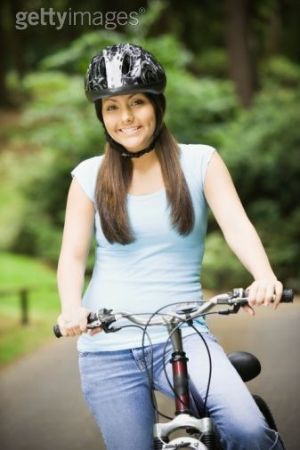
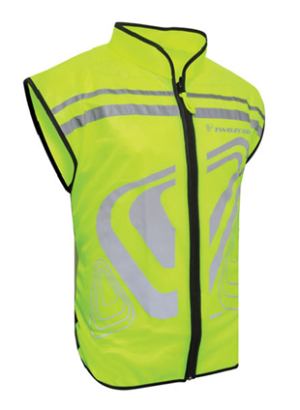

Cycling
Notes:
Thinking as a cyclist what can you do to be safer?
Helmet - Hi Viz/Bright Clothing - Cycle Training

Slide 10
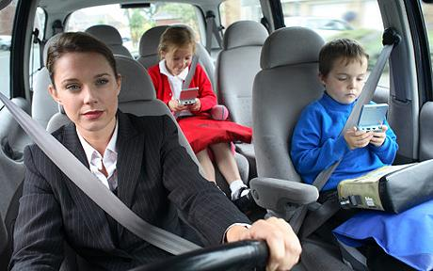
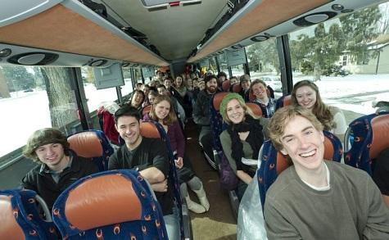
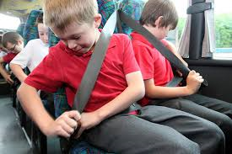
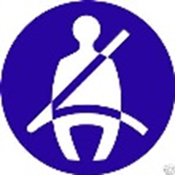
Passenger
Notes:
Thinking as a passenger what can we do to be safer?
Seat belt – don’t distract the driver – loose objects
Wearing seatbelt correctly, shoulders/hips. Not under arm, not around back. No feet on dash!!

Slide 11
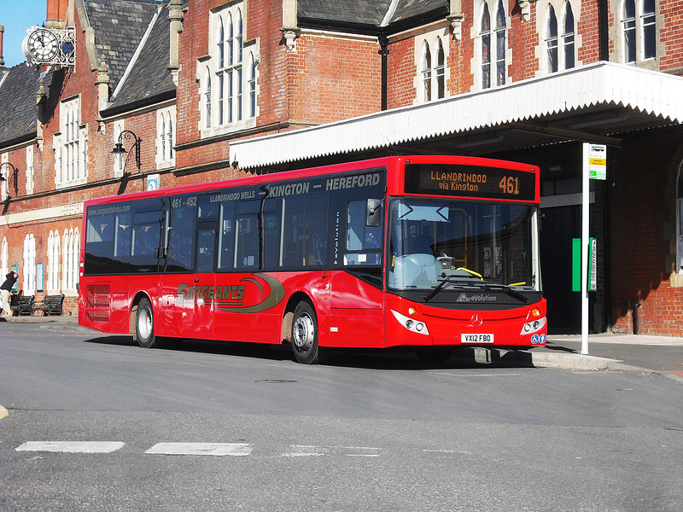
Travelling by Bus
School Bus MUST have seatbelts – YOU MUST WEAR THEM!
Public Buses sometimes have seatbelts – if they have, WEAR THEM!
Buses are operated by bus companies like Yeomans, DRM, Sargeants phone them if the bus is late/doesn’t arrive
How to get on and off Tickets Money

Slide 12
Plan & Prepare
Talk to your parents/carers about your new journey
Trial run the journey if you can
What to do if things don’t go to plan?
Know where you are, keep alert & keep in touch
I.C.E In case of Emergency and what3words app
Notes:
Plan your route – use the route planner I‘m leaving with you.

Slide 13
Have a great summer, remember to STOP LOOK LISTEN THINK
Back to basics: GREEN CROSS CODE
Wear your seat belt properly, every time
Don’t distract the driver
Wear a helmet; Get trained; Be Seen
Choose the safest route you can, use safer crossing places and let people know where you are
Notes:
Pedestrian:
Focus on the road when crossing and not your mates or mobile phone.
Try not to get complacent about traffic by paying attention at all times.
Don’t get distracted when crossing roads. If you are on your phone, tell the other person to hold before resume the conversation once you’re across the road.
It’s harder to think about two things at once than you might think. (Possibly pass a ball between two friends while asking them set questions)
Cross roads in places where drivers can see you, using a pedestrian crossing if possible. If there’s no crossing, make sure you are seen.
If you need to cross, stop, look both ways, listen and only cross if there’s nothing coming. Keep looking and listening while you cross.
Don’t mess about near roads or put your mates at risk. Mates look out for each other. Think how you’d feel if you were responsible for one of your mates getting seriously hurt or suffering a life changing injury.
If you live in the countryside think about wearing something bright and reflective – very important in autumn and winter especially if you have to walk home after getting dropped off by bus.
Passenger:
Remember to put your seat belt on whether you are in the front seat or rear seat, or if you are a passenger on a bus or coach.
If you are in the back seat and are involved in a collision and you are not wearing your seat belt you could hurt the person who you love the most, mum or dad. If they are driving you will be thrown from your seat and will hit them.
Avoid distracting the driver. Particularly when travelling by bus or coach. Also, when travelling on public transport remember to keep the noise down, don’t through things and sit down throughout the journey putting bags and any belongings in either the overhead luggage rack or under the seat in front of you.
Cyclist:
Think about your safety. Is your bike road worthy with two working brakes? Are you wearing hi viz clothing and helmet? Do you know the route to school? Is there an alternative route that uses quieter roads or even better a cycle path? Have you got lights fitted on your bike if it’s going to be dark?
Remember to choose safe routes and make every journey as safe
as possible. You are already doing a very good job keeping yourself safe on or near our roads so please continue to do that.

Slide 14

Thank you
If you would like any further information :
Road Safety Team
roadsafety@herefordshire.gov.uk
01432 260946

