Slide 1

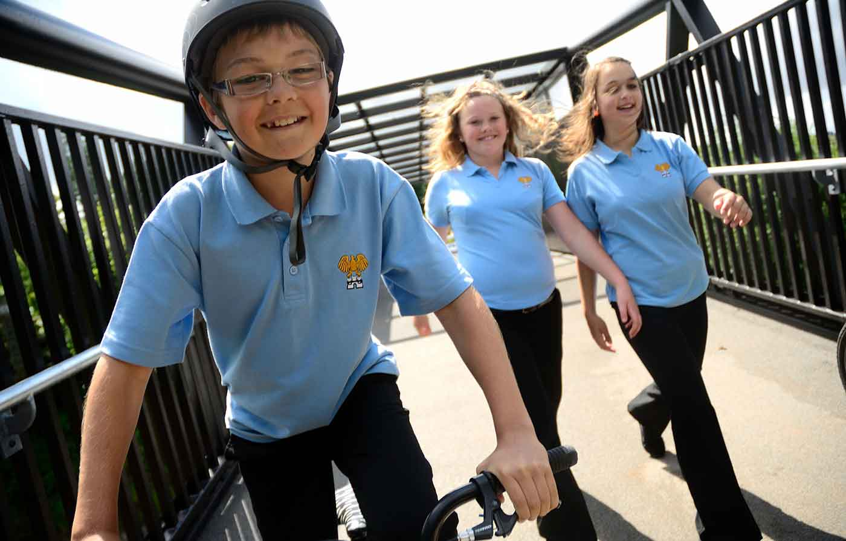
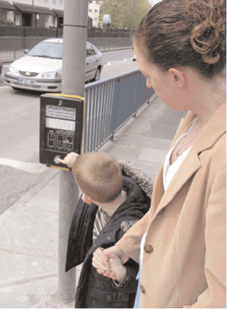
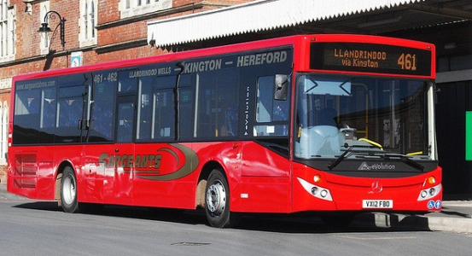
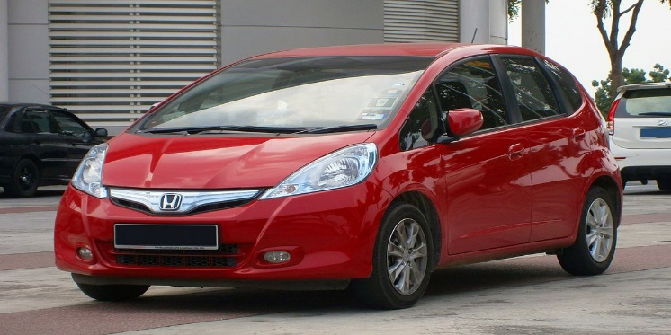
Pedestrian safety
How do you usually get to school?

Slide 2

Pavements, car parks and driveways

Slide 3
Road safety questions

Slide 4
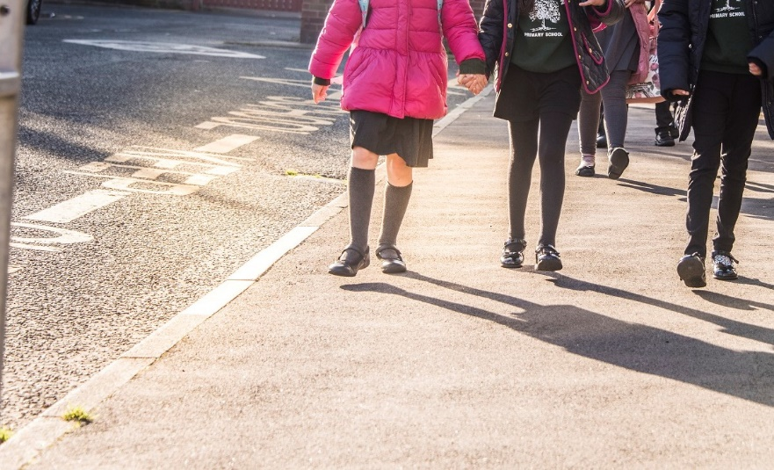
You should always walk on the pavement, not run.
What could happen if you run?
Kerb
Pavement

Slide 5
If you run on the pavement or across this road this might happen.
I may trip or fall over
I might run into the road
I may bump into someone on the pavement
I don’t have time to stop, look and listen
I make mistakes when I rush

Slide 6
Look for hazards

Slide 7
How can you tell if a car is about to move?
What clues can you hear and see?

Slide 8
Is there a driver in the car?
Can you see any lights?
Can you hear the engine?
Driver Lights Engine

Slide 9
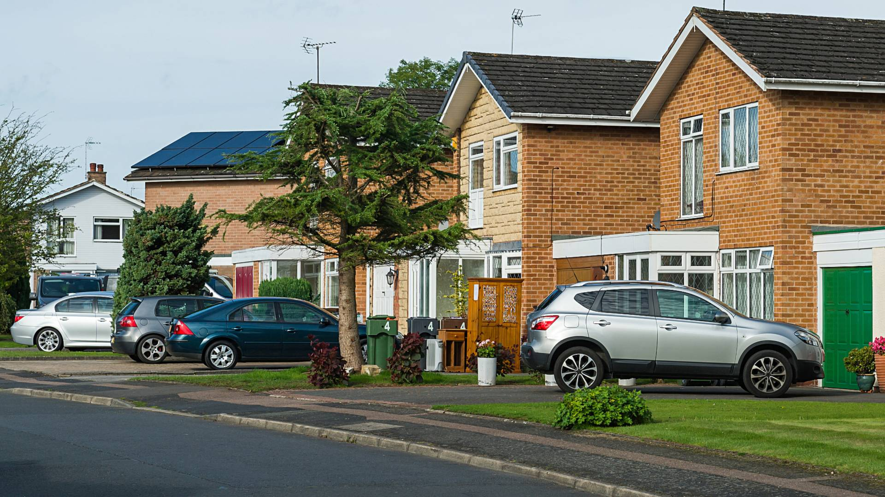
Traffic may turn into or out of driveways
what should we do when we walk past driveways?

Slide 10
Stop/wait Look Listen

Slide 11
Why may drivers not see children?
  I am smaller than adults
  Cars and other traffic are bigger than me
  I can move quickly

Slide 12
How to cross: The Green Cross Code

Slide 13
How to cross the road questions

Slide 14
How to cross the road answers

Slide 15
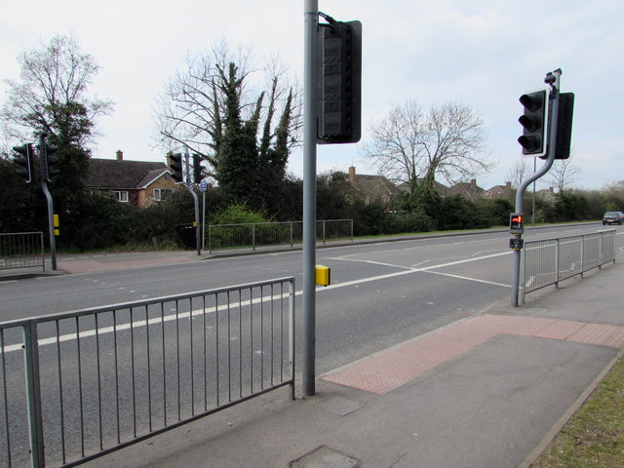
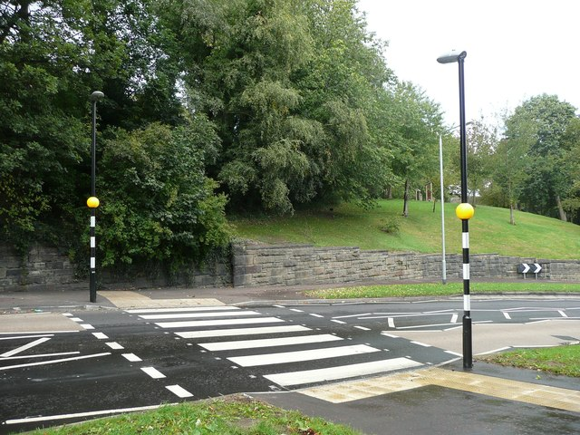
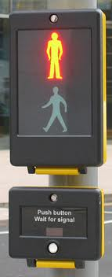
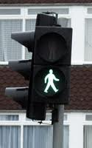
crossings
Puffin Pegasus
Pelican Toucan
Zebra

Slide 16
Safer crossing places

