Slide 1
Using a pedestrian crossing safely

Slide 2
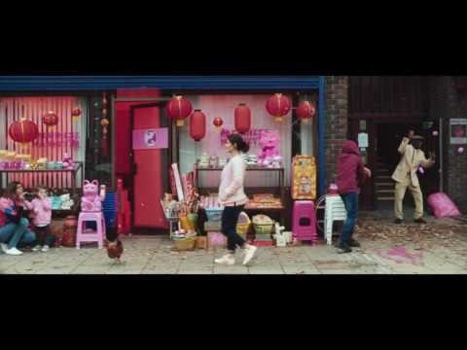
A busy street
Notes:
Although pedestrians can’t control how drivers behave behind the wheel we should do as much as we can to protect ourselves, this means following some rules but the mainly being aware, attentive and looking properly. Many collisions (both vehicle and pedestrians) result from ‘failed to look’ which is a failure to look properly, assess the situation and take time to think through consequences of actions.
How well do you look, do you actually see? Our brain is very good at making assumptions about what is actually in front of us – I thought the car was slowing down, I thought the car was turning etc, that aren’t real.
Take a look at the film ‘pink kittens’ how many do you spot? How good is your concentration and how well does your brain tell you what is real and what you ‘think you see’ ?
Teacher: If the film fails to play in powerpoint the source of this film is available on Youtube titled Pink Kitten. This film was made by Think!, the UK’s road safety education and publicity arm of Dept for Transport and is aimed at drivers using their phones while driving but it works well to get students attention and get them thinking about how their brain works.

Slide 3
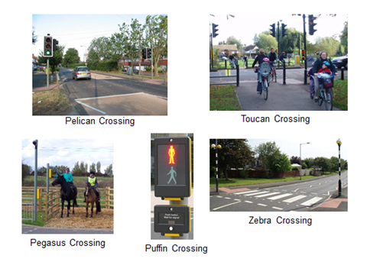
Safer crossing places
Notes:
There are many types of crossing out there but they are all there to help us cross busy roads.
Zebra crossings are the oldest type of crossing and don’t use traffic lights to stop the traffic, this is the only crossing where pedestrians have priority but you must still be sure the traffic is stopped or coming to a stop before you step out. It’s a good idea to look at the driver, make eye contact, to be sure they’ve seen you.
In our busier streets you find light controlled crossings instead, such as pelican or puffin which manage higher volumes of traffic better because traffic lights stop the traffic.
Toucan crossings (Two-can-cross) are usually found near cycle routes and allow pedestrians and people on bikes to cross together.
At all other crossings people on bikes should dismount and walk their bikes across the crossing.

Slide 4
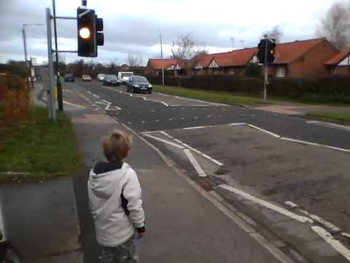
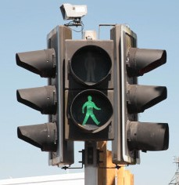
Pelican Crossing
P pedestrian
E
L light
I
C controlled
A
N
Notes:
The crossing you have by your school is a Pelican crossing, controlled by traffic lights to stop traffic and the red standing man and green walking man to control pedestrians crossing which you have to watch out for across the road. There may also be an audible sound to help pedestrians know when the green man appears and/or an aid for visually impaired pedestrians which we can see in the next picture.
Drivers will be alerted to a crossing ahead by road signs and, as they approach, there will be white lines and zig zag markings, it’s likely the speed limit will also be lower in areas of high pedestrian use, such as around schools, shops and homes. You may even have flashing lights on the road outside school activated at school start and finish times to alert drivers to children.

Slide 5
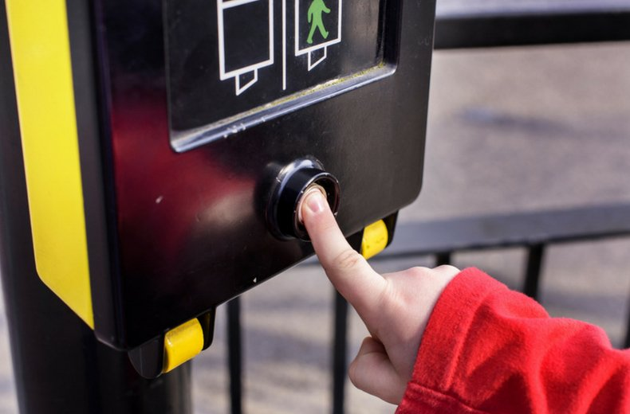
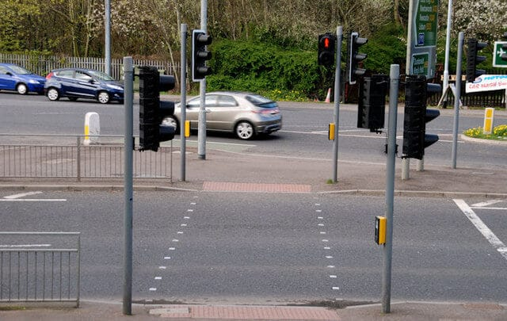
Using the crossing
Notes:
This is what you will see, a white button to activate the crossing and instructions lit up on the screen asking pedestrians to wait until the green man shows. The yellow rollers you can see here move round when the green man show and visually impaired pedestrians will be trained how to use crossings by holding these until they start to move, there is also tactile paving at the edge of crossing (the bumpy pavement either ridges or round raised areas) this is felt through our feet, alerting us that the road is close and we are about to leave the pavement. There are also studs running across the road keeping pedestrians within the crossing and helping people to follow a straight route across.
So how does a pelican crossing work? – next slide

Slide 6
How does a Pelican work?
Simple crossing - pedestrian and light controlled
no cameras or pedestrian detectors
pedestrian activates the crossing using the button
Red light stops traffic
Red man stops pedestrians
Green light should mean traffic has stopped
Only crossing with an amber light phase and flashing green man
Notes:
A Puffin crossing is more sophisticated and is the Pelican’s younger model. A pelican has no cameras monitoring pedestrians crossing, a puffin does. If there are cameras on a pelican it’s likely they are monitoring traffic and/or have enforcement role to check drivers are obeying red lights. A puffin has the red and green man beside the pedestrian at the kerb, the pelican’s red and green man are across the street.
So what does it mean that it’s the only crossing with an amber light phase and flashing green man? See next slide

Slide 7
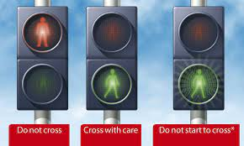
Flashing green man phase
Notes:
Here’s the flashing green man phase that only a pelican crossing has. If the green man flashes while you are already on the crossing, continue to cross but if he is flashing before you step out then you don’t have time to cross safely so wait at the kerb and press the button again.
Drivers will see a flashing amber light which allows them to drive forward if no-one is on the crossing, if there is they must wait until the pedestrian is on the pavement before the continue driving.

Slide 8
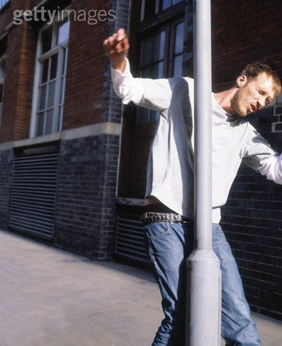
Watch where you are going
Notes:
Watch where you’re going! it’s easy to get distracted and make a mistake. Please use the crossing and make sure you walk within the studs, crossing between the waiting cars could mean drivers don’t see you as they focus on children using the crossing and the traffic lights, if the lights change and traffic starts to move you could be caught in the middle. Always wait for the green man, don’t risk crossing on the red man and never run across the road, you might trip and fall.
Teacher – you can expand on why children are vulnerable road users, (their size, inexperience and impulsive behaviour) what could happen if you run near roads either on the pavement or across the road – trip, slip, fall, bump into other peds. Not take the time necessary to see, hear and make correct decisions. Rushing leads to mistakes.
Emphasise that most children can get around safely, take your time to see and hear properly, use crossing places to cross busy roads and be aware of your surrounds at all times. Watch out for bicycles and electric vehicles that you can’t hear and may surprise you.
For further work:
Ask students to plan a route to walk using safe routes, you could use Hereford mini-maps or google maps. Ask them to use an area known to them eg around their home and plan a journey to somewhere they are likely to drive to and see if they could plan to walk instead, are there safe short-cuts?
Debate the benefits of walking versus using a car. - on the individual/on society/on our environment
Encourage a discussion on how vehicle emissions affect the environment
Other sources of info; www.sustrans.org.uk www.brake.org.uk www.think.gov.uk

